Slide 1
Detect fraudulent click traffic for mobile app ads
The Kaggle Challenge: Build an algorithm that predicts whether a user will download an app after clicking a mobile app ad

Slide 2
Background
For companies that advertise online, click fraud can happen at an overwhelming volume, resulting in misleading click data and wasted money.
The train and test data sets are provided by Talking data, China’s largest independent big data service platform, covers over 70% of active mobile devices nationwide.

Slide 3
Variables
· ip: ip address of click. · app: app id for marketing. · device: device type id of user mobile phone (e.g., iphone 6 plus, iphone 7, huawei mate 7, etc.) · os: os version id of user mobile phone · channel: channel id of mobile ad publisher · click_time: timestamp of click (UTC) · attributed_time: if user download the app for after clicking an ad, this is the time of the app download · is_attributed: the target that is to be predicted, indicating the app was downloaded
New variables as indicators
Ip_day_hour_channelcount
Ip_app_channelcount
Ip_channel_appcount:

Slide 4
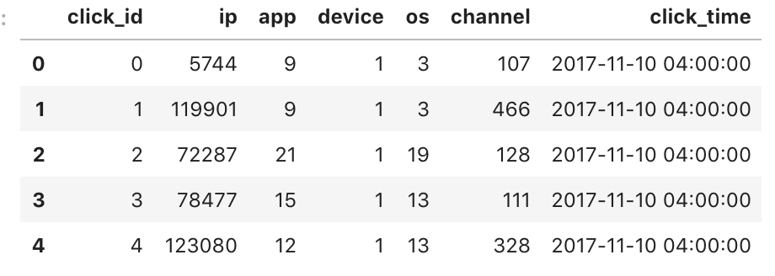
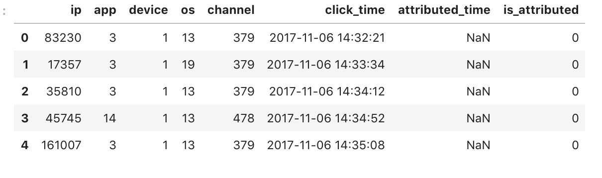
Test Dataset
Train Dataset

Slide 5
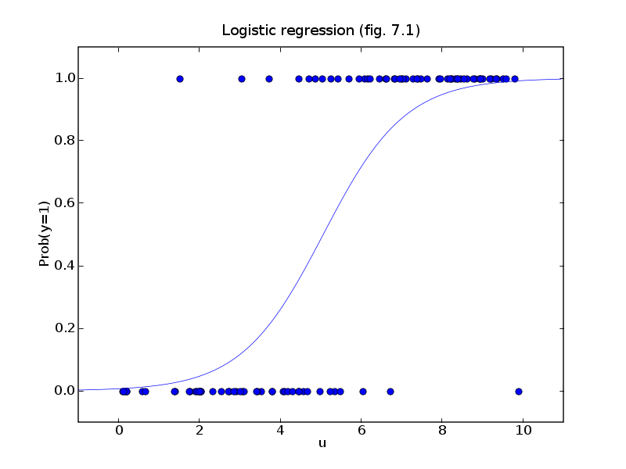
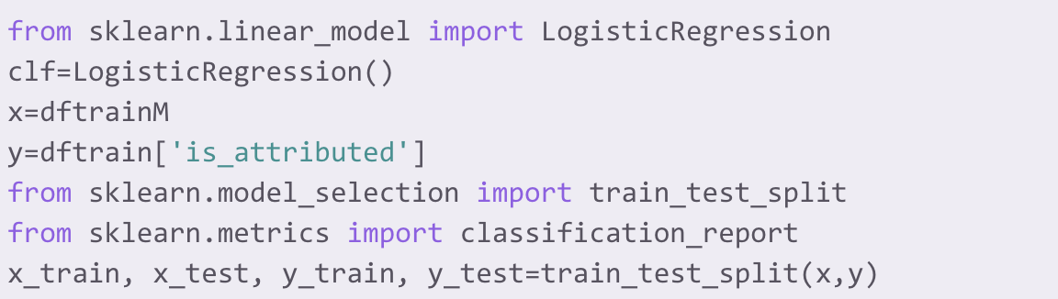
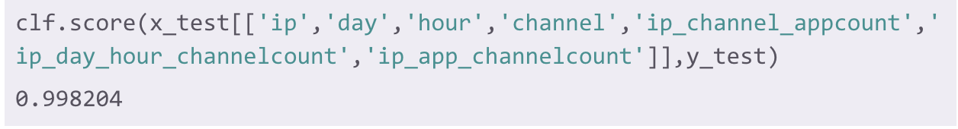
Classifiers
Logistic Regression: It has a sigmoidal shape which is best fit for analyzing a dataset with binary dependent variable.
I splitted the train dataset into four sub groups: train_x, train_y, test_x, and test_y. By comparing the result of this prediction to test_y, I can decide how accurate is this classifier.

Slide 6
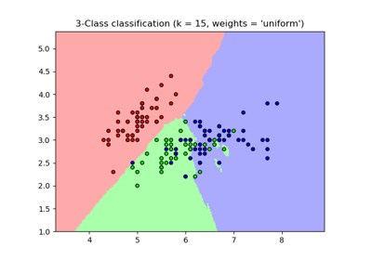
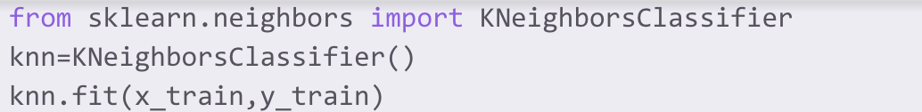
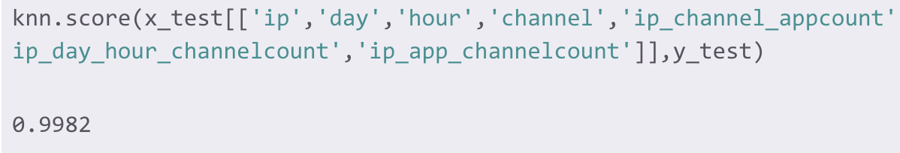
Classifiers
KNeighborsClassifier: This is a non-parametric algorithm and classify based on similarity. It looks at how closely the sample’s features resemble the training data set and make decision accordingly.

Slide 7
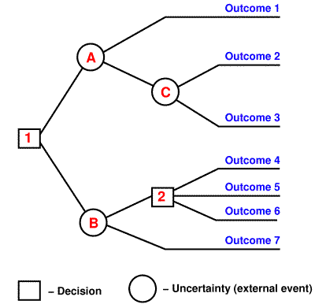
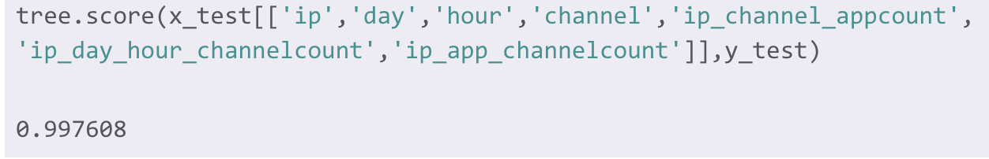
Classifiers
Decision tree: it uses a tree-like model of decisions and their possible consequences to make predictions on certain input.

Slide 8
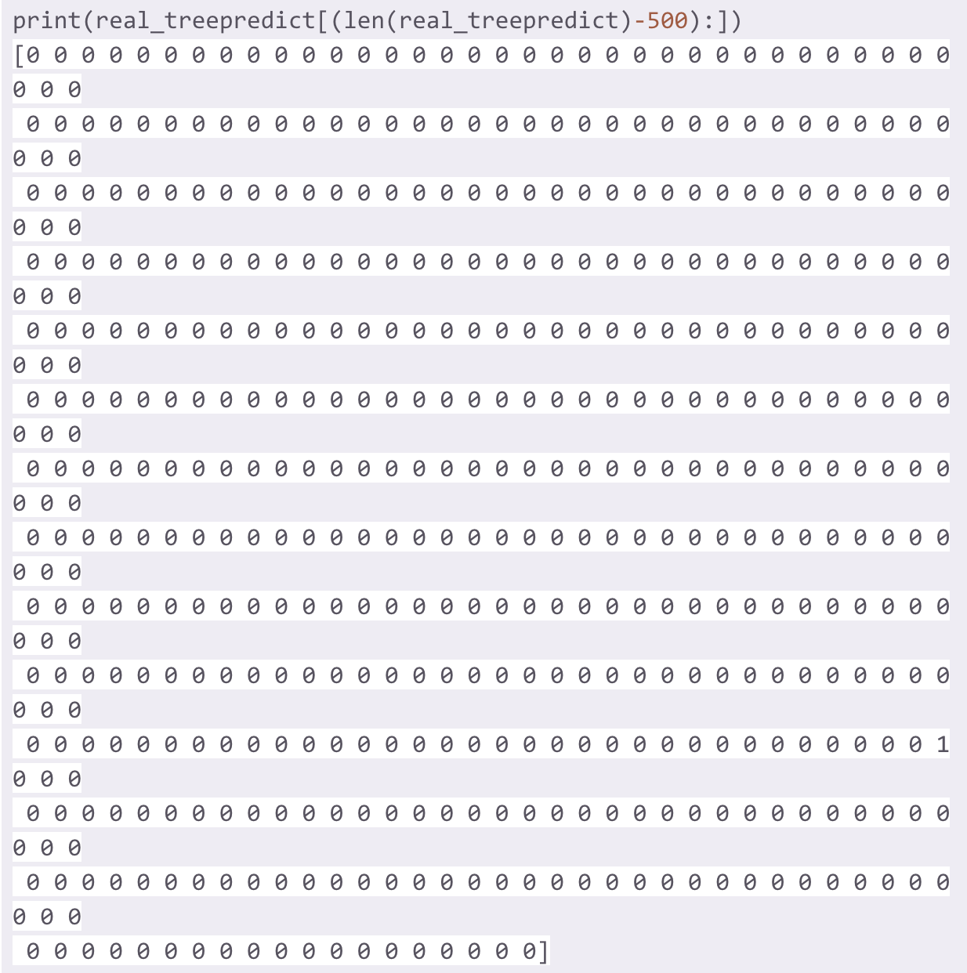
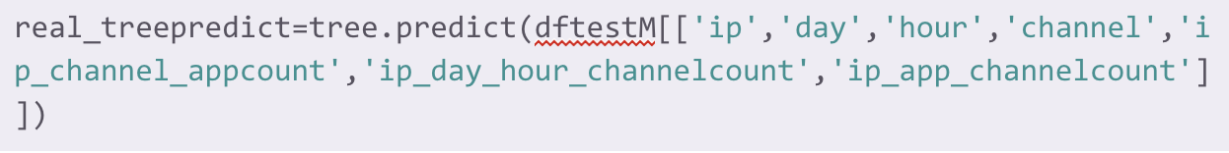
Predict test data
The decision tree classifier has the highest score comparing to the others. So I used the real test data on this model.

Slide 9
https://github.com/zhanx145/code-toolkit

